Slide 1
DP02 – Apache Flink
Course: INTRODUCTION TO BIG DATA

Slide 2
GROUP: KHMT2-03
Nguyễn Quốc Anh 21127007
Phạm Phi Sơn 21127418
Mạc Tuấn Trung 21127462
Nguyễn Cao Khôi 21127632

Slide 3
Table of Contents
01
02
03
04
Introduction
A deeper insight to Apache Flink
Apache Flink Demo
Discussions & Conclusions

Slide 4
01
Introduction

Slide 5

Apache Flink is an open-source stream processing framework
Process and analyze large volumes of continuous streams of data with low latency and high throughput in distributed systems.

Slide 6
02
A deeper insight to Apache Flink

Slide 7
A deeper insight to Apache Flink
2.1
Major components and main functionalities
2.2
API’s and Libraries
2.3
Popularity
2.4
Comparison

Slide 8
Major components and main functionalities

Slide 9
Some concepts and why Apache Flink?
Provides a powerful and scalable distributed runtime engine.
Flink can handle both stream and batch processing.
Flink's checkpointing mechanism ensures quick recovery from failures.
Flink integrates with various systems and libraries.

Slide 10

Major components and main functionalities
Apache Flink's Stream Processing
Apache Flink’s Architecture
Apache Flink’s Application

Slide 11
Apache Flink’s Stream Processing

Slide 12
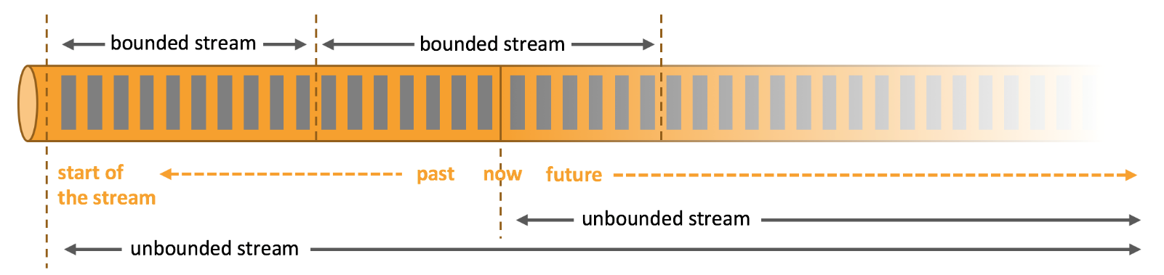
Apache Flink's Stream Processing
Bounded Stream
Unbounded Stream
Have begin point and end point (also called batch)
Have begin point but no end point. May come continuously and never stop
All the data need to be collected and put on the systems before processing
Can’t wait for all data to arrive before processing

Slide 13
Apache Flink's Stream Processing
Flink strong in processing real-time data stream
Unlike batch processing, we can not re-check hold the data to find something
⇒ Need to store valuable information in the past
⇒ “State”

Slide 14


Apache Flink's Stream Processing
State
Visitor
Count += 1
⇒ State is information that derived from the previous-seen events

Slide 15
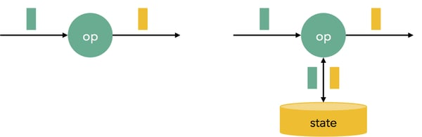
Apache Flink's Stream Processing
Stateless Transformation
Stateful Transformation
Transformations applied to each element of a stream independently
Transformations require access to state information while processing
Output only determined by the input element itself
Past events can influence the way current events are processed and the output results

Slide 16
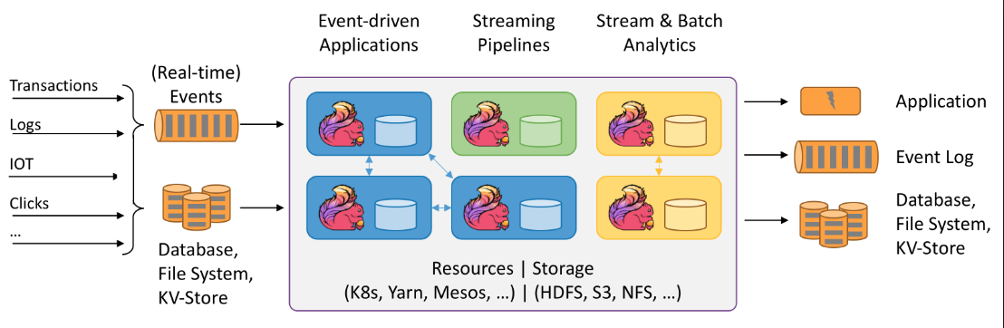
Apache Flink's Stream Processing
ETL Pipeline (Extract, Transform, Load)

Slide 17






Apache Flink's Stream Processing
ETL Pipeline (Extract, Transform, Load)
Extract
Transform
Load

Slide 18
Apache Flink’s Architecture

Slide 19
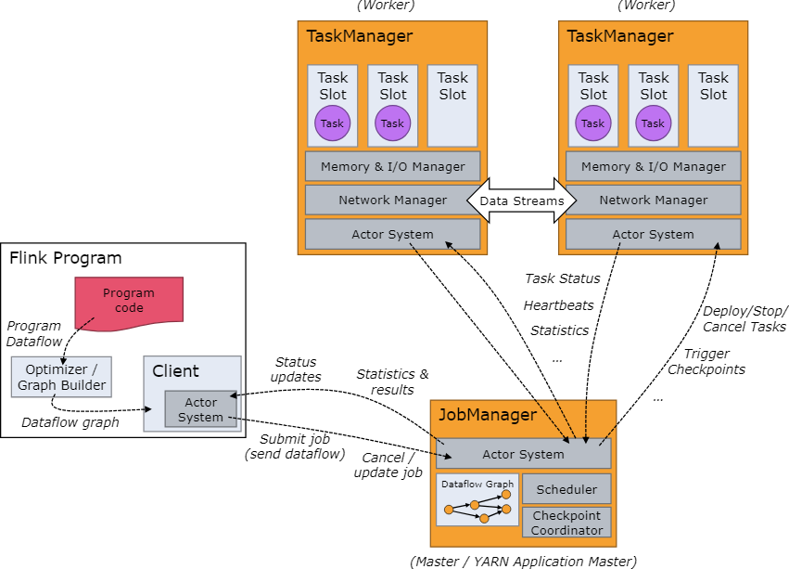
Apache Flink’s Architecture

Slide 20

Apache Flink’s Architecture
To coordinate, distribute the execution of Flink Applications

Slide 21
Apache Flink’s Architecture
ResourceManager
Dispatcher
JobMaster

Slide 22
Apache Flink’s Architecture
ResourceManager
does the resource allocation and deallocation in a Flink cluster
takes responsibility for running the Flink Web user interface and provides REST interface to submit Flink applications for execution
Dispatcher
JobMaster
manage the execution of a single JobGraph

Slide 23
Apache Flink’s Architecture
Apache Flink’s Architecture
ResourceManager
does the resource allocation and deallocation in a Flink cluster
Executes the tasks of a dataflow, and buffer and exchange the data stream
takes responsibility for running the Flink Web user interface and provides REST interface to submit Flink applications for execution
Dispatcher
JobMaster
manage the execution of a single JobGraph. Every job has its own JobMaster and many jobs can run at the same time.

Slide 24
Apache Flink’s Architecture
Execute subtasks in separate threads
This task slot occupied 1/3 resources of the TaskManager

Slide 25
Apache Flink’s Architecture
Operators
# | Operator | Transformation | Description
1 | Map | DataStream → DataStream | Take one element to create another one.
2 | FlatMap | DataStream → DataStream | Take one element to create nothing, one or more elements.
3 | Filter | DataStream → DataStream | A bool function. Each element (in the DataStream) which makes the function return true will be retained.
4 | KeyBy | DataStream → KeyedStream | Divide DataStream into separate partitions. All elements with the same key will be assigned into the same partition.
5 | Reduce | KeyedStream → DataStream | A function combines the current element with the last reduced value to create a new value.
6 | Window | KeyedStream → WindowedStream | Windows group the data in each key (KeyedStream) according to some characteristic

Slide 26
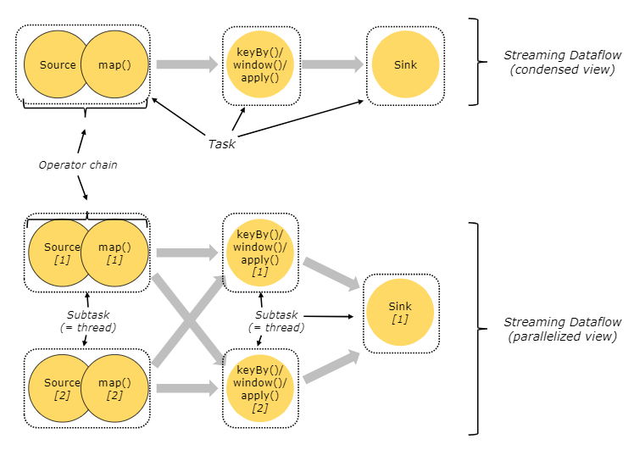
Apache Flink’s Architecture
Tasks and Operator Chains
Chains operators together into tasks
These operators will be allocated within the same thread

Slide 27
Apache Flink’s Architecture
Tasks and Operator Chains
Reduce the transferring of tasks between threads and decrease buffering
Higher overall performance & minimize latency

Slide 28
APIs and libraries

Slide 29
APIs and Libraries
APIs
High-level Analytics API
SQL/TABLE API (dynamic tables)
Stream & Batch Processing
DataStream API (streams, windows)
Expensiveness
Conciseness
Stateful Event
ProcessFunction (events, state)

Slide 30
APIs and Libraries
Flink ML
Graph Processing Library
CEP
Machine learning APIs and infrastructures that simplify the building of ML pipelines
Methods for graph processing and is particularly useful for batch processing
Detecting complex patterns in event streams.

Slide 31
Applications

Slide 32
Recommender Systems
Flink can power recommendation systems by processing user interactions in real-time to generate personalized recommendations.
Real-time Data Processing
Event Time Processing
Low Latency

Slide 33

Fraud Detection
Flink’s ability to process data in real-time makes it well-suited for fraud detection applications.
Timely responses are crucial.
Detect fraud transaction immediately.

Slide 34
Popularity

Slide 35
Community size
Apache community
Apache Flink community
The Apache Software Foundation (ASF) provides support and infrastructure for a wide range of projects covering areas:
Web servers
Big data
Artificial intelligence
Networking,…
Flink is still quite new, and the community is not too strong.
Hard to research and find an optimal solution when some problems occur.

Slide 36



Industries
Many tech companies, enterprises, and research institutions have embraced Flink for its advanced real-time stream processing capabilities.
Real-time analytics
Data processing tasks
Real-time event processing
Monitoring
Analytics
Real-time analytics
Fraud detection
Recommendation systems

Slide 37
Comparison

Slide 38




Comparison
VS

Slide 39
Comparison
VS
Lazy Transformations
In-memory processing
Processing data streaming

Slide 40
Comparison
VS
Programming Model
DataStream API for continuously streams processing and DataSet API for batch processing
Built-in support for managing stateful computations
Use Resilient Distributed Dataset (RDD), which is immutable distributed collections of objects
State need to be stored in external systems and limited support for stateful computations

Slide 41
Comparison
VS
Latency
Native support for data streaming processing
→ Low latency in processing data streaming
Optimized for batch processing and micro-batch streaming
→ Streaming data is collected as fixed mini-batch and applied batch processing
→ Higher latency than Flink

Slide 42
Comparison
VS
Fault Tolerance
Mechanism called "checkpointing"
It periodically saves the state of the streaming application → recover in case of failures.
Information is stored in RDDs, which enables it to recompute lost partitions in case of failures.

Slide 43
03
Demonstration

Slide 44
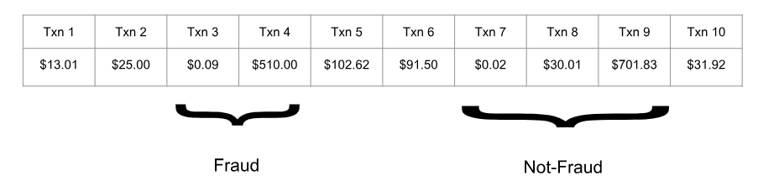
Demonstation
Fraud Detection

Slide 45
04
Discussions Conclusion

Slide 46
Advantages
Low latency Stream Processing, enabling real-time analytics.
Scalability, due its great parallel capabilities.
Stateful Processing, providing several built-in fault tolerance systems.
Flexibility, supporting both batch and stream processing.

Slide 47
Disadvantages
Python/SQL API still misses a few features in comparison with the Java/Scala.
Complicated documentations, not user-friendly.
Community smaller than other frameworks.

Slide 48
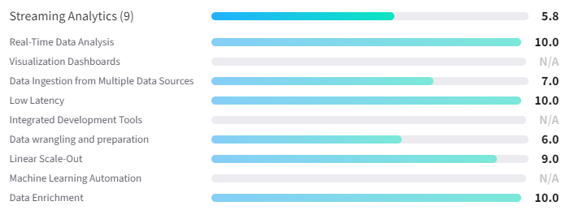
Apache Flink Feature Ratings
https://www.trustradius.com/products/apache-flink/reviews?qs=feature-ratings#reviews

Slide 49
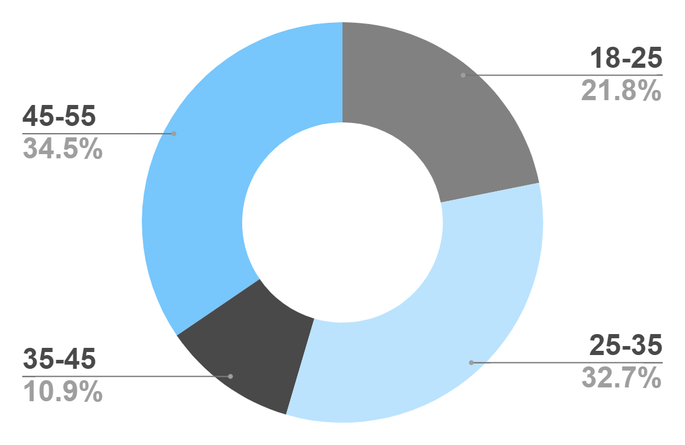
When Apache Flink ?
Fault tolerance and consistency are crucial.
Event-driven Applications
IoT sensor data processing.
Clickstream analysis.
Log monitoring.
Real-time Analytics
Monitoring user activities.
Analyzing IoT device data.
Processing financial transactions in real-time.

Slide 50
Conclusion

Slide 51


Special Thanks To
Lecturers
Lê Ngọc Thành | Nguyễn Ngọc Thảo
Đỗ Trọng lễ | Bùi Huỳnh Trung Nam
And All Your Attention
https://flink.apache.org/
https://nightlies.apache.org/flink/flink-docs-stable/

